Slide 1
CGB1201-JAVA PROGRAMMIMG PROJECT REVIEW
Department of Artificial Intelligence and Machine Learning
Academic Year: 2024 – 2025 (Odd Semester)
Register Number : 2303811714822037
Name : Ranjani V
Year : II
Semester : III
Section : A
Date : 03.12.2024

Slide 2
E-COMMERCE PLATFORM IN JAVA

Slide 3
Abstract
This project focuses on developing an e-commerce platform using Java, designed to provide a seamless and efficient online shopping experience for both customers and vendors.
The platform supports essential e-commerce features, including user registration, product catalog browsing, shopping cart management, secure payment processing, and order tracking.
It ensures scalability and security through modular architecture and adherence to industry-standard practices such as role-based access control, data encryption, and secure APIs.

Slide 4
Introduction
An e-commerce platform is a web-based system that facilitates buying and selling of goods and services over the internet. The platform must provide features like product catalog management, user authentication, order processing, payment integration, and more. Using Java as the primary technology ensures scalability, security, and performance—critical aspects for handling large-scale e-commerce applications.

Slide 5
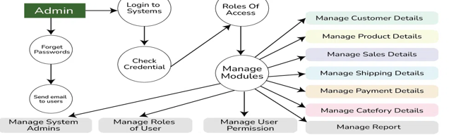
Proposed Architecture

Slide 6
Proposed Architecture - Description
The API layer facilitates communication between the frontend and the backend using RESTful services, exposing endpoints for operations like creating an account, adding products to the cart, or processing an order.
When a customer adds items to their cart and proceeds to checkout, the Order Service is responsible for creating a new order.

Slide 7
Proposed Architecture - Description (Cont..)
When a customer places an order or an item is returned, the stock service updates the inventory accordingly. It ensures that the stock levels are accurate in real time and reflects any changes due to purchases, refunds, or restocking.
When a customer proceeds to checkout and chooses a payment method (credit card, PayPal, etc.), the payment service initiates the transaction.
The OMS communicates with the delivery service to provide real-time order status updates (e.g., order picked, in transit, delivered).

Slide 8
List of Modules
User Management Module
Handles user registration, login, and profile management.
Role-based access (e.g., admin, seller, customer).
Password encryption and secure authentication.
2.Product Management Module
Create, update, delete, and list products.
Manage categories, brands, and attributes.
Support for product images and videos.

Slide 9
Module Description
3.Catalog Management Module
Organize products into hierarchical categories.
Enable filters and search functionality (e.g., by price, brand, category).
Manage product availability and inventory status.
4.Shopping Cart Module
Add, update, and remove products from the cart.
Calculate total prices, taxes, and discounts.
Support for guest carts and persistent carts for logged-in users.

Slide 10
Module Description (Cont..)
5.Shipping and Delivery Module
Integration with logistics and shipping providers (e.g., FedEx, UPS).
Calculate shipping costs based on weight, size, and location.
Track shipment status and provide updates to customers

Slide 11
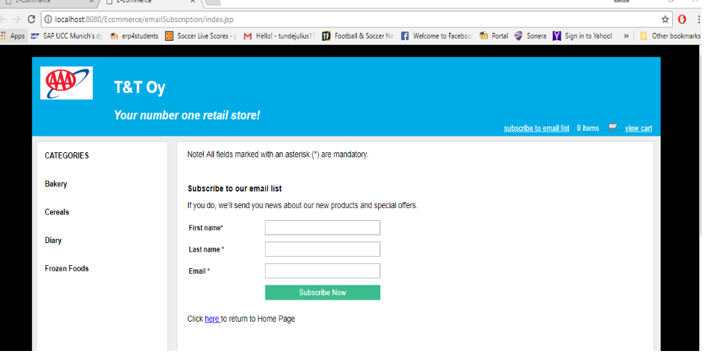
Results and Discussion (Cont..)

Slide 12
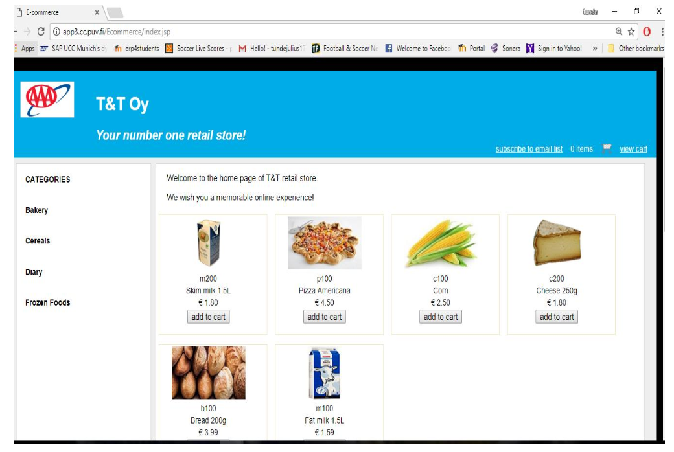
Results and Discussion

Slide 13
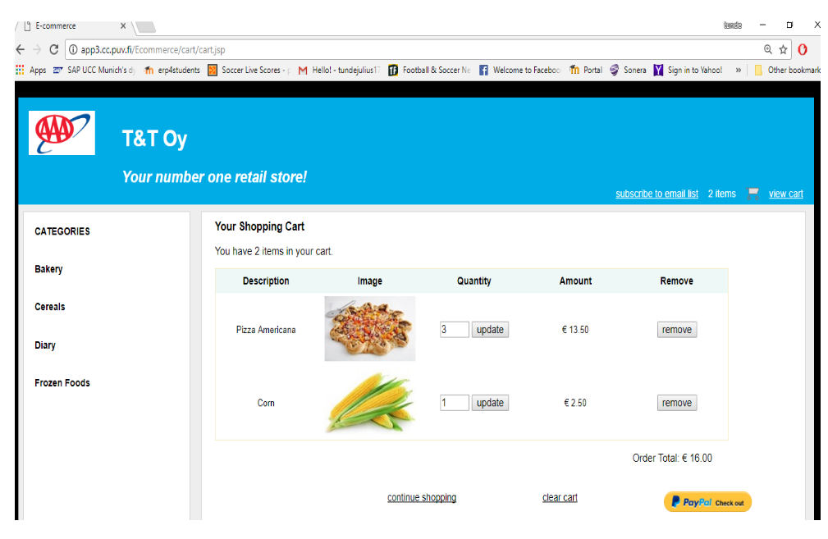
Results and Discussion

Slide 14
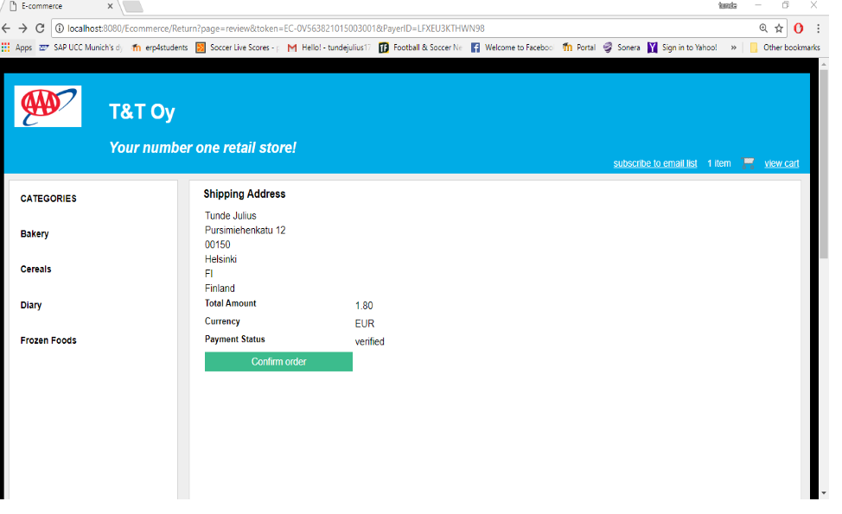
Results and Discussion

Slide 15
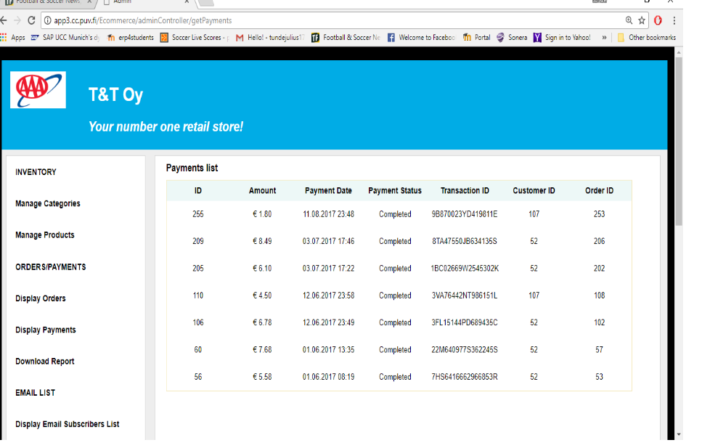
Results and Discussion (Cont..)

Slide 16
Conclusion
The development of an e-commerce platform using Java provides a robust, scalable, and secure solution for online retail businesses. By leveraging Java's powerful frameworks, such as Spring Boot and Hibernate, the platform is able to offer essential functionalities like user management, product catalog handling, order processing, payment integration, and inventory control, all while ensuring security, performance, and ease of maintenance.

Slide 17
Thank You

